Slide 1
Cheltenham Association Football League Clubs Meeting Wednesday, 19th August, 2015

Slide 2
Agenda
Welcome – League Chairman
Apologies– League Secretary
Charity Cup Set-Up 2015-16 – League Chairman
Charity Cup Draw 2015-16
Registrations – Registration Secretary
Discipline – Discipline Secretary
Yearbook
Fixtures – Fixtures Secretary
Open Invitation to Clubs to Attend Meetings with the Management Committee
AOB (must have been previously notified to League Secretary)
Date of Next Meeting – Clubs Meeting – Wednesday 13th January 2016

Slide 3
Agenda
Welcome – League Chairman
Apologies– League Secretary
Charity Cup Set-Up 2015-16 – League Chairman
Charity Cup Draw 2015-16
Registrations – Registration Secretary
Discipline – Discipline Secretary
Yearbook
Fixtures – Fixtures Secretary
Open Invitation to Clubs to Attend Meetings with the Management Committee
AOB (must have been previously notified to League Secretary)
Date of Next Meeting – Clubs Meeting – Wednesday 13th January 2016

Slide 4
Agenda
Welcome – League Chairman
Apologies– League Secretary
Charity Cup Set-Up 2015-16 – League Chairman
Charity Cup Draw 2015-16
Registrations – Registration Secretary
Discipline – Discipline Secretary
Yearbook
Fixtures – Fixtures Secretary
Open Invitation to Clubs to Attend Meetings with the Management Committee
AOB (must have been previously notified to League Secretary)
Date of Next Meeting – Clubs Meeting – Wednesday 13th January 2016

Slide 5
Agenda
Welcome – League Chairman
Apologies– League Secretary
Charity Cup Set-Up 2015-16 – League Chairman
Charity Cup Draw 2015-16
Registrations – Registration Secretary
Discipline – Discipline Secretary
Yearbook
Fixtures – Fixtures Secretary
Open Invitation to Clubs to Attend Meetings with the Management Committee
AOB (must have been previously notified to League Secretary)
Date of Next Meeting – Clubs Meeting – Wednesday 13th January 2016

Slide 6
Cheltenham Association Football League Charity Cup Set Up 2015-16

Slide 7
Senior Charity Cup
26 Entrants - 13 Teams from both Divisions 1 & 2
1st Round - Saturday, 10th October, 2015
- 10 Ties, involving 20 teams
- 6 byes
- Losing teams into GMB Senior Trophy
2nd Round - Saturday, 12th December, 2015
- 8 Ties, involving 10 winners & 6 byes
Quarter Finals - Saturday, 30th January, 2016
Semi-Finals & Final – To Be Arranged

Slide 8
Junior Charity Cup
22 Entrants - 12 Teams from Div 3, 10 from Div 4
1st Round - Saturday, 10th October, 2015
- 6 Ties, involving 12 teams
- 10 byes
- Losing teams into GMB Primary Trophy
2nd Round - Saturday, 12th December, 2015
- 8 Ties, involving 6 winners & 10 byes
Quarter Finals - Saturday, 30th January, 2016
Semi-Finals & Final – To Be Arranged

Slide 9
Minor Charity Cup
16 Entrants - 3 Teams from Div 4, 13 from Div 5
Cheltenham Civil Service IV
Shurdington Rovers Reserves
Southside Star IV
1st Round – Group Stage
- 4 Groups of 4 teams
- 03/10/15, 10/10/15 & 07/11/15
- Top 2 teams qualify for Quarter Finals
- 3rd Place teams to GMB Primary Trophy
Quarter Finals - Saturday, 30th January, 2016
Semi-Finals & Final – To Be Arranged

Slide 10
GMB Senior Trophy
10 Entrants – Senior Charity Cup 1st Round Losers
1st Round – Fri 11th / Sat 12th December 2015
- 2 Ties involving 4 teams
- 6 byes
- Both Games on AstroTurf
Quarter Finals - Fri 18th / Sat 19th December 2015
- All games played on AstroTurf
Semi Finals - Sat 2nd January 2016
- Both games played on AstroTurf
Final - Fri 29th January 2016 – on AstroTurf

Slide 11
GMB Primary Trophy
10 Entrants – Junior Charity Cup 1st Round
Losers & Minor Charity Cup 3rd Placed teams
1st Round – Fri 11th / Sat 12th December 2015
- 2 Ties, involving 4 teams
- 6 byes
- Both Games on AstroTurf
Quarter Finals - Fri 18th / Sat 19th December 2015
- All games played on AstroTurf
Semi Finals - Sat 2nd January 2016
- Both games played on AstroTurf
Final - Fri 29th January 2016 – on AstroTurf

Slide 12
Charity Cup Semi-Finals 2016
Following significant interest from numerous member clubs, the League intends to accept tenders for the right to host Junior & Minor Charity Cup Semi-Finals for the 2015-16 season.
Any club which would like to host a Junior and Minor Charity Cup Semi-Final, on the same night, is invited to register its tender with the League’s General Secretary by November 30th 2015 Further details of the requirements of the tender can also be obtained from the General Secretary

Slide 13
Agenda
Welcome – League Chairman
Apologies– League Secretary
Charity Cup Set-Up 2015-16 – League Chairman
Charity Cup Draw 2015-16
Registrations – Registration Secretary
Discipline – Discipline Secretary
Yearbook
Fixtures – Fixtures Secretary
Open Invitation to Clubs to Attend Meetings with the Management Committee
AOB (must have been previously notified to League Secretary)
Date of Next Meeting – Clubs Meeting – Wednesday 13th January 2016

Slide 14
Agenda
Welcome – League Chairman
Apologies– League Secretary
Charity Cup Set-Up 2015-16 – League Chairman
Charity Cup Draw 2015-16
Registrations – Registration Secretary
Discipline – Discipline Secretary
Yearbook
Fixtures – Fixtures Secretary
Open Invitation to Clubs to Attend Meetings with the Management Committee
AOB (must have been previously notified to League Secretary)
Date of Next Meeting – Clubs Meeting – Wednesday 13th January 2016

Slide 15
Cheltenham Association Football League Charity Cup Draw 2015-16

Slide 16
Agenda
Welcome – League Chairman
Apologies– League Secretary
Charity Cup Set-Up 2015-16 – League Chairman
Charity Cup Draw 2015-16
Registrations – Registration Secretary
Discipline – Discipline Secretary
Yearbook
Fixtures – Fixtures Secretary
Open Invitation to Clubs to Attend Meetings with the Management Committee
AOB (must have been previously notified to League Secretary)
Date of Next Meeting – Clubs Meeting – Wednesday 13th January 2016

Slide 17
Agenda
Welcome – League Chairman
Apologies– League Secretary
Charity Cup Set-Up 2015-16 – League Chairman
Charity Cup Draw 2015-16
Registrations – Registration Secretary
Discipline – Discipline Secretary
Yearbook
Fixtures – Fixtures Secretary
Open Invitation to Clubs to Attend Meetings with the Management Committee
AOB (must have been previously notified to League Secretary)
Date of Next Meeting – Clubs Meeting – Wednesday 13th January 2016

Slide 18
Cheltenham Association Football League Registrations

Slide 19
Registrations 2015-16
4 Methods of Registration
NO INPUT TO FULL TIME REQUIRED!!
1. Signing the Re-Registration Form (now CLOSED!!!)
2. Signing a New Registration Form
For which details of the Player’s Cheltenham League club for season 2014/15 HAVE been entered
INPUT TO FULL TIME REQUIRED!!
3. Signing a New Registration Form
For which details of the Player’s Cheltenham League club for season 2014/15 have NOT been entered
4. Pitch-Side Signings on Match Days
Form must be submitted within 2 DAYS – change to SCoR

Slide 20
Registration Process
When inputting new players on Full-Time for the Registration Secretary to approve,
an electronic copy of the associated registration form must be emailed to the Registration Secretary on the same day
so that Registrations can be processed
straight away.

Slide 21
Agenda
Welcome – League Chairman
Apologies– League Secretary
Charity Cup Set-Up 2015-16 – League Chairman
Charity Cup Draw 2015-16
Registrations – Registration Secretary
Discipline – Discipline Secretary
Yearbook
Fixtures – Fixtures Secretary
Open Invitation to Clubs to Attend Meetings with the Management Committee
AOB (must have been previously notified to League Secretary)
Date of Next Meeting – Clubs Meeting – Wednesday 13th January 2016

Slide 22
Agenda
Welcome – League Chairman
Apologies– League Secretary
Charity Cup Set-Up 2015-16 – League Chairman
Charity Cup Draw 2015-16
Registrations – Registration Secretary
Discipline – Discipline Secretary
Yearbook
Fixtures – Fixtures Secretary
Open Invitation to Clubs to Attend Meetings with the Management Committee
AOB (must have been previously notified to League Secretary)
Date of Next Meeting – Clubs Meeting – Wednesday 13th January 2016

Slide 23
Cheltenham Association Football League Discipline

Slide 24
Disciplinary Matters
Those clubs that have players still left to serve match suspensions from last season MUST notify either the GFA or the WFA of the match or matches they will miss so that an end date can be given; Full-Time can then be updated. This should help to save clubs from playing an ineligible player.
Remember: suspensions relate to the team for which the player picked up the suspension & not the club – i.e. if it was for 2 matches for the 3rds, that team needs to play 2 games before the player can take part in any other games for their club.

Slide 25
Disciplinary Matters
The CDP 2 list is up to date and the League’s Disciplinary Secretary will continue to email clubs when he is informed that players have cleared their debt.
Clubs can check a player’s eligibility by going on to the County website (GFA or WFA ) & using the search facility.
It is a Cheltenham League instruction that all cautions & dismissals are included on match returns on Full-Time - failing to comply will result in a charge.

Slide 26
Disciplinary Matters
If you have a player dismissed from the field of play this player WILL be suspended 14 days after the offence, even if no paperwork has been received by the club.
Therefore it is YOUR responsibility to inform your County FA if you have NOT received any paperwork after 7 days.

Slide 27
Agenda
Welcome – League Chairman
Apologies– League Secretary
Charity Cup Set-Up 2015-16 – League Chairman
Charity Cup Draw 2015-16
Registrations – Registration Secretary
Discipline – Discipline Secretary
Yearbook
Fixtures – Fixtures Secretary
Open Invitation to Clubs to Attend Meetings with the Management Committee
AOB (must have been previously notified to League Secretary)
Date of Next Meeting – Clubs Meeting – Wednesday 13th January 2016

Slide 28
Agenda
Welcome – League Chairman
Apologies– League Secretary
Charity Cup Set-Up 2015-16 – League Chairman
Charity Cup Draw 2015-16
Registrations – Registration Secretary
Discipline – Discipline Secretary
Yearbook
Fixtures – Fixtures Secretary
Open Invitation to Clubs to Attend Meetings with the Management Committee
AOB (must have been previously notified to League Secretary)
Date of Next Meeting – Clubs Meeting – Wednesday 13th January 2016

Slide 29
Cheltenham Association Football League Yearbook

Slide 30
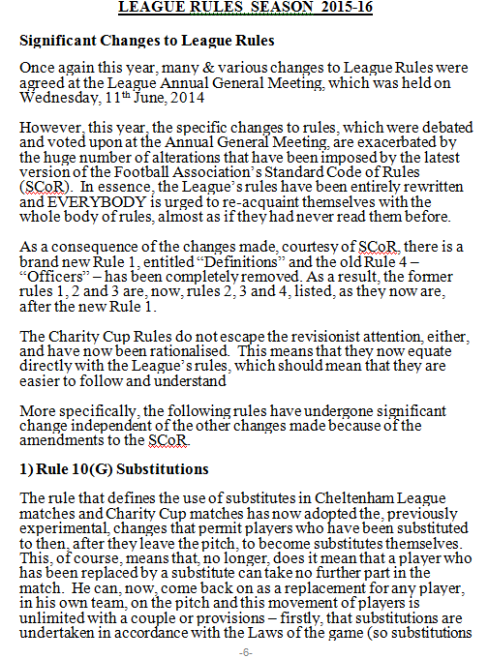
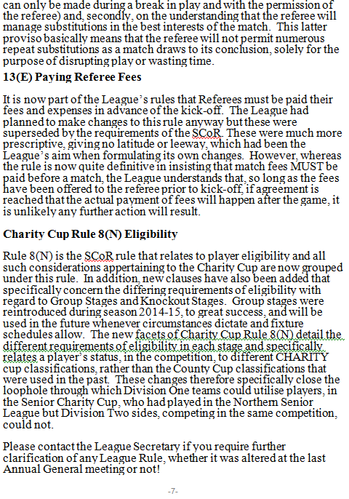
Yearbook

Slide 31
Agenda
Welcome – League Chairman
Apologies– League Secretary
Charity Cup Set-Up 2015-16 – League Chairman
Charity Cup Draw 2015-16
Registrations – Registration Secretary
Discipline – Discipline Secretary
Yearbook
Fixtures – Fixtures Secretary
Open Invitation to Clubs to Attend Meetings with the Management Committee
AOB (must have been previously notified to League Secretary)
Date of Next Meeting – Clubs Meeting – Wednesday 13th January 2016

Slide 32
Agenda
Welcome – League Chairman
Apologies– League Secretary
Charity Cup Set-Up 2015-16 – League Chairman
Charity Cup Draw 2015-16
Registrations – Registration Secretary
Discipline – Discipline Secretary
Yearbook
Fixtures – Fixtures Secretary
Open Invitation to Clubs to Attend Meetings with the Management Committee
AOB (must have been previously notified to League Secretary)
Date of Next Meeting – Clubs Meeting – Wednesday 13th January 2016

Slide 33
Cheltenham Association Football League Fixtures

Slide 34
Agenda
Welcome – League Chairman
Apologies– League Secretary
Charity Cup Set-Up 2015-16 – League Chairman
Charity Cup Draw 2015-16
Registrations – Registration Secretary
Discipline – Discipline Secretary
Yearbook
Fixtures – Fixtures Secretary
Open Invitation to Clubs to Attend Meetings with the Management Committee
AOB (must have been previously notified to League Secretary)
Date of Next Meeting – Clubs Meeting – Wednesday 13th January 2016

Slide 35
Agenda
Welcome – League Chairman
Apologies– League Secretary
Charity Cup Set-Up 2015-16 – League Chairman
Charity Cup Draw 2015-16
Registrations – Registration Secretary
Discipline – Discipline Secretary
Yearbook
Fixtures – Fixtures Secretary
Open Invitation to Clubs to Attend Meetings with the Management Committee
AOB (must have been previously notified to League Secretary)
Date of Next Meeting – Clubs Meeting – Wednesday 13th January 2016

Slide 36
Cheltenham Association Football League Open Invitation to Clubs

Slide 37
Open Invitation to Clubs
The League extends an Open Invitation to ALL CLUBS to meet with the Management Committee and discuss any matter relating to League Affairs on the following dates:
15th October, 12th November, 17th December,
4th February, 11th March.
All of these Meetings will be held at the Dowty Club in Staverton.
No Appointment Necessary

Slide 38
Agenda
Welcome – League Chairman
Apologies– League Secretary
Charity Cup Set-Up 2015-16 – League Chairman
Charity Cup Draw 2015-16
Registrations – Registration Secretary
Discipline – Discipline Secretary
Yearbook
Fixtures – Fixtures Secretary
Open Invitation to Clubs to Attend Meetings with the Management Committee
AOB (must have been previously notified to League Secretary)
Date of Next Meeting – Clubs Meeting – Wednesday 13th January 2016

Slide 39
Agenda
Welcome – League Chairman
Apologies– League Secretary
Charity Cup Set-Up 2015-16 – League Chairman
Charity Cup Draw 2015-16
Registrations – Registration Secretary
Discipline – Discipline Secretary
Yearbook
Fixtures – Fixtures Secretary
Open Invitation to Clubs to Attend Meetings with the Management Committee
AOB (must have been previously notified to League Secretary)
Date of Next Meeting – Clubs Meeting – Wednesday 13th January 2016

Slide 40
Cheltenham Association Football League Any Other Business

Slide 41
Cheltenham Association Football League Next Meeting Wednesday, 13th January, 2016

